Slide 1
Node.js Course – 1st Session
Node.js Overview
Jim Chen
Jul 2017

Slide 2
Agenda
1
Node.js Basic Instruction
2
Node.js Setup
3
Simple HTTP Server
4
Node.js Module
5
NPM
6
Node.js async
7
Node.js debug
8
Exercise

Slide 3
1
Node.js Basic Instruction
Node.js® is a JavaScript runtime built on Chrome's V8 JavaScript engine.
Node.js uses an event-driven, non-blocking I/O model that makes it lightweight and efficient.
Node.js' package ecosystem, npm, is the largest ecosystem of open source libraries in the world.
Notes:
Node.js采用事件驱动、异步编程，为网络服务而设计
事件驱动这个词并不陌生，在某些传统语言的网络编程中，我们会用到回调函数，比如当socket资源达到某种状态时，注册的回调函数就会执行。Node.js的设计思想中以事件驱动为核心，它提供的绝大多数API都是基于事件的、异步的风格。

Slide 4
1
What is a MEAN stack
MongoDB as the database
Express as the web framework
AngularJS as the frontend framework, and
Node.js as the server platform

Slide 5
2
The advantages of MEAN stack
Support for the MVC pattern
JSON is used for transferring data
Node.js huge module library(200k+)
Open source
Single language is used in the whole application

Slide 6
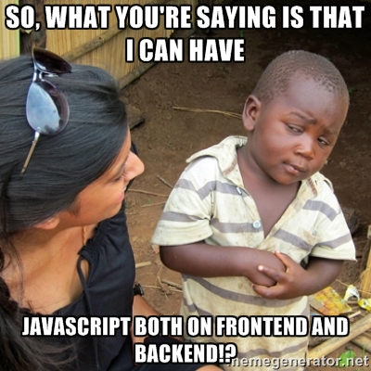

Slide 7
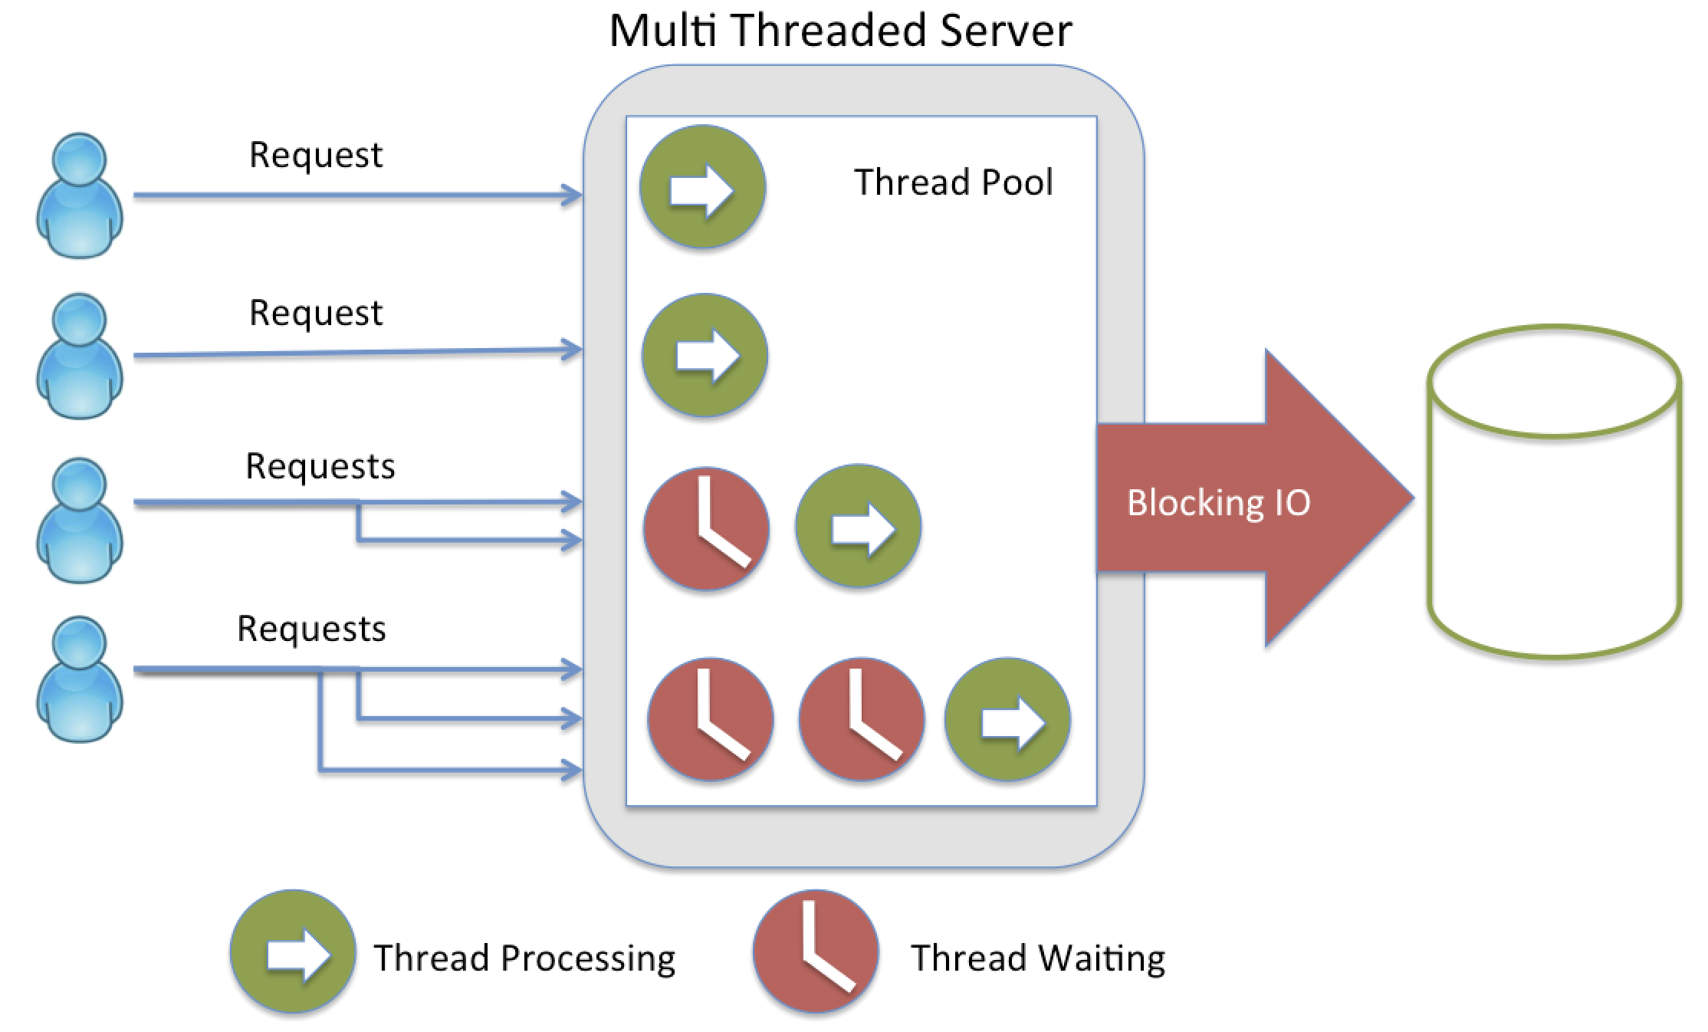
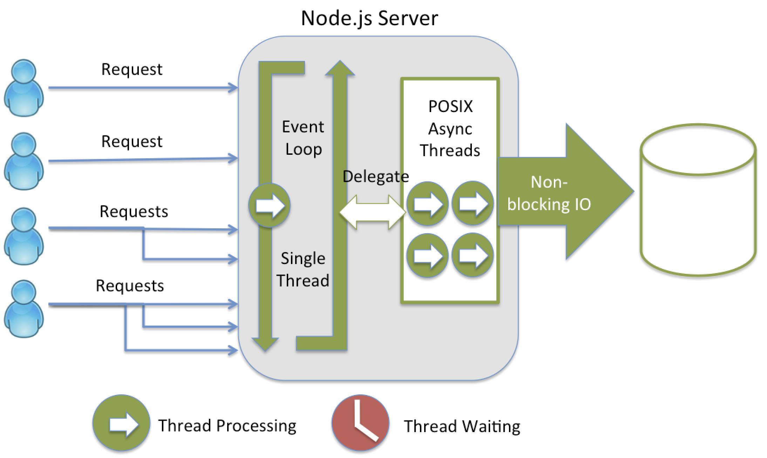
3
Node.js server VS traditional server

Slide 8
2
Node.js Setup

Slide 9
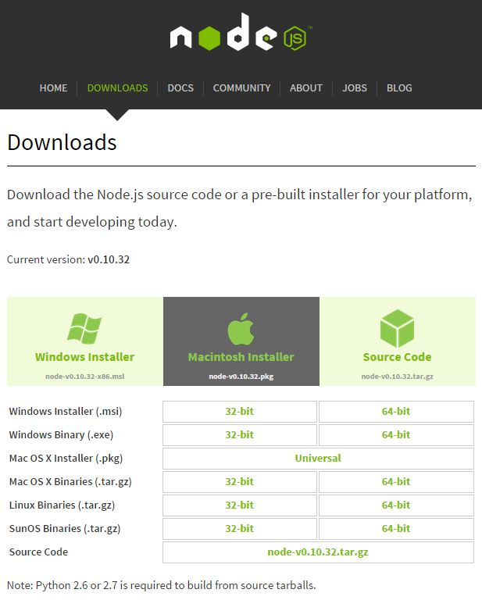
1
How to start Node.js journey
Install related OS version of Node.js from http://nodejs.org/

Slide 10

2
How to start Node.js journey
After installation, add Node.js installation path to Windows Environment Variable Path
Open your CMD in Windows, check installation is ok
Now, we can start run JavaScript in REPL
Notes:
Show in windows CMD
REPL Read–eval–print loop

Slide 11
3
Simple HTTP Server

Slide 12
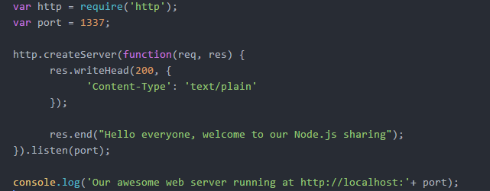
1
Simple HTTP Server
Notes:
var http = require(‘http’);
http.createServer(function(req, res) {res.writeHead(200,{'Content-Type':'text/plain'}); res.end('Hello NodeJS!'); }).listen(8888);

Slide 13
4
Node.js Module

Slide 14
6
Node Module
A CommonJs implement
One files to one modules
Caching
Variable scope isolation between module files

Slide 15
1
Node.js Module
Core Modules：events, fs, http
File Modules：express, socket.io

Slide 16
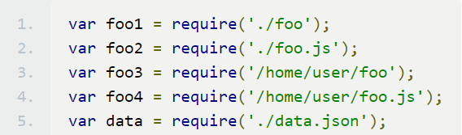
2
Node.js require
Core Modules
var http = require(‘http’);
File Modules
$ npm install express

Slide 17
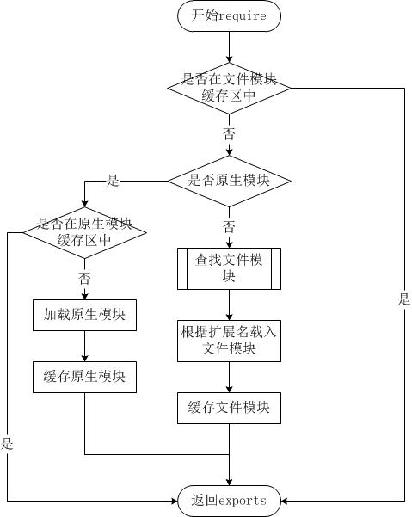
5
Node Module—Load Module

Slide 18
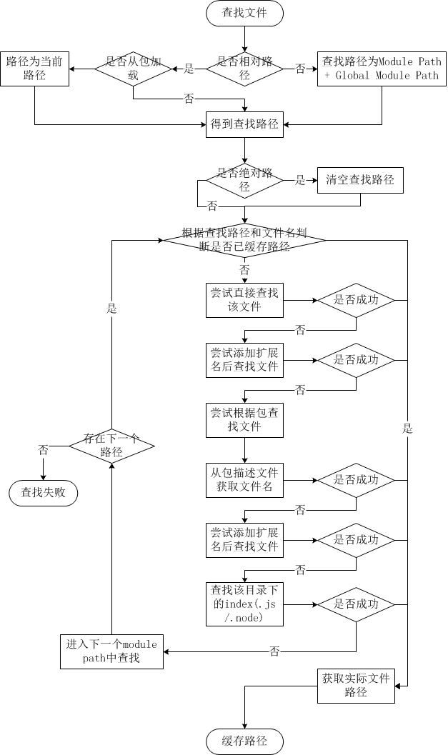
4
Node Module—Find File Strategy

Slide 19
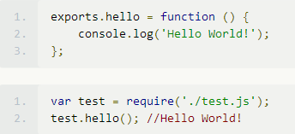
3
exports & module.exports
Exports is the export object of the current module
Public properties and methods

Slide 20
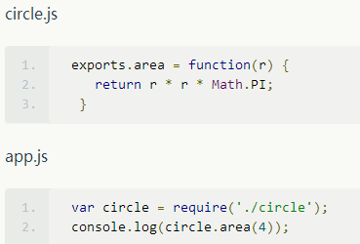
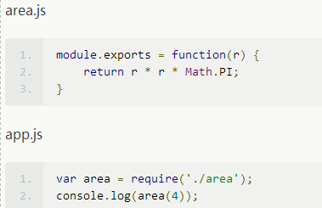
3
exports & module.exports
exports = module.exports = {};

Slide 21
Module Sample

Slide 22
5
NPM – Node.js Package Management

Slide 23

1
NPM
Node.js Package Management will provide a solution to manage your third-party library, like Maven
When your install Node.js, NPM is built-in installed.

Slide 24
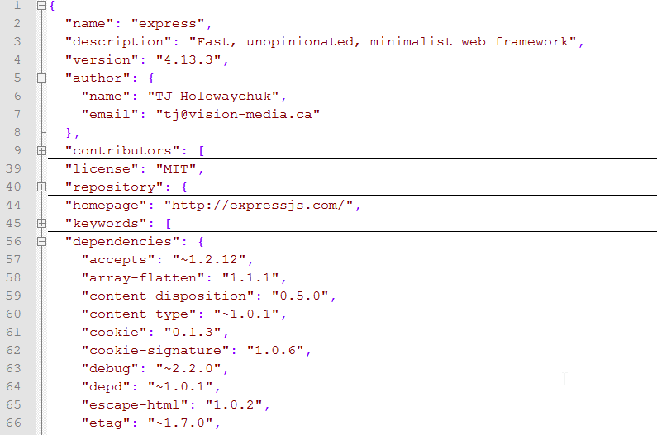
2
package.json
package.json file is located at the root path of project and described project information, include below
Project name
Project owner
Project license
Project dependencies
Customized commands
……
Sample express/package.json

Slide 25
3
Use NPM Create a Node.js Project
In Windows CMD, input below command
After initialization is done, input below command to install dependencies (--save will add the dependency in package.json file automatically)
$ npm init
$ npm install --save <package name>

Slide 26
6
Node.js async

Slide 27
1
Node.js async
Node.js runs on a single threaded event loop and leverages asynchronous calls for various things, like I/O operations.
So many Node.js API is using “callback”, like “fs” module
Notes:
http://justinklemm.com/node-js-async-tutorial/

Slide 28

2
Node.js async
What does “callback” mean?
fs.readFile(“./test.txt”, callback_function);
Means: when the “text.txt” file is finished reading, Node.js event loop will call the “callback_function” to process the pre-defined logic, and it will embedded 2 parameters (err, data) to this function.

Slide 29
6
Node.js debug

Slide 30
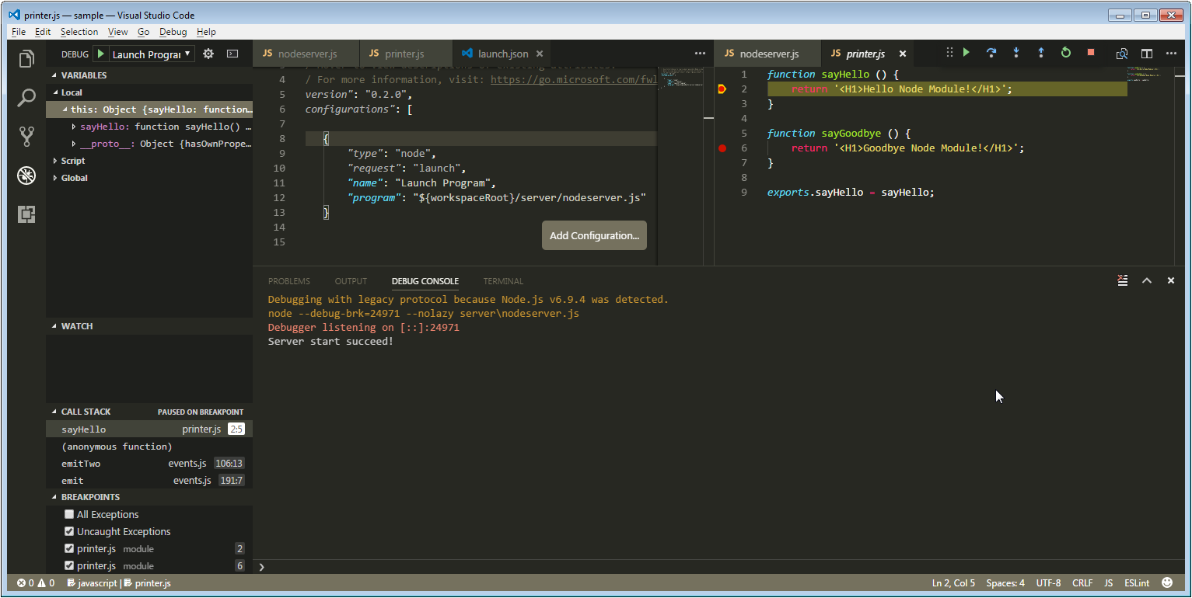
1
VSCode Debuger

Slide 31
7
Exercise

Slide 32
1
Exercise
Read a file abc.txt in C:\
Write a HTTP Server, print out c:\abc.txt with H1 and blue color, and listen 9999 port

Slide 33
8
Reference
https://nodejs.org
http://nodeschool.io/

